Slide 1
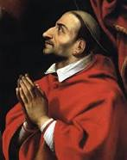
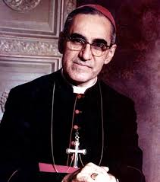
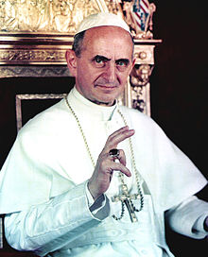
October GIFT
Called to be Saints
Please help yourself to dinner
Pray the table prayer together.
And be sure to do the discussion with your family.
The prayer and questions are on your table sign.
St. Charles Borromeo
St. Oscar Romero
St. Paul VI

Slide 2
City of God
Awake from your slumber! Arise from your sleep!
A new day is dawning, for all those who weep
The people in darkness, have seen a great light
The lord of our longing , has conquered the night
Refrain: Let us build the city of God.
May our tears be turned into dancing!
For the Lord, our light and our love,
Has turned the night into day!
We are sons of the morning. We are daughters of day.
The One who has loved us, has brightened our way
The Lord of all kindness , has called us to be
A light for his people, to set their hearts free.

Slide 3
Here I am Lord

Slide 4
Video: You Don’t Know Jack Saints (Access at Busted Halo)

Slide 5
Discussion Questions
What is a saint?
How does someone become a saint?
What are some qualities of a saint?
Can you name some of the saints?

Slide 6
Activity 1 Saints and The Beatitudes

Slide 7
Activity 2 Our Patron Saint and Our Newest Saints (Blank paper for the posters is on the left hand side of the folder)

Slide 8
City of God
O Comfort my people; make gentle your words
Proclaim to my city the day of her birth.
City of gladness now lift up your voice!
Proclaim the good tidings that all may rejoice!
Refrain: Let us build the city of God.
May our tear be turned into dancing!
For the Lord, our light and our love,
Has turned the night into day!

Slide 9
We appreciate your help with clean up!
Homework for our next GIFT session is online
Please hand in your attendance sheet at the door before you leave
Have a wonderful week!

