Slide 1
God’s callings are all around us but we don’t always see them

Slide 2
Creating a Culture of Calling
WHAT IS IT?
A grant-funded initiative to promote a parish culture of calling that helps Christians of all ages discover their purpose throughout life and equips them to live their vocation in the church community, at home, and in the world.

Slide 3
24 Churches Chosen to Participate Invited congregations reflect a diversity of location, size, denomination, and ethnicity; have demonstrated an ability to provide high quality worship and faith formation for all ages and generations, and provide a positive, supportive environment to implement new projects and initiatives.
Ascension Catholic Church, Portland, OR All Saints Anglican, Durham, NC Central United Methodist Church, Waterford, MI Church of the Apostles, Fairfield, CT Church of the Presentation, USR, NJ First AME Church, Las Vegas, NV First Presbyterian Church, Allentown, PA First United Methodist Church, Lkeland, FL Florence Christian Church, Florence KY Lord of Life Lutheran, Fairfax VA Metropolitan AME Church, Washington DC Palm Harbor United Methodist Church, Palm Harbor, FL
Prince of Peace Lutheran, Burnsville, MN Reid Temple AME Church, GlennDale MD
Round Hill Community Church, Gnwch,CT Sacred Heart Parish, Southbury, CT St Anthony on the Lake, Peewaukee, WI St. Charles Catholic Parish, Portland OR St. Charles Borromeo Church, Skillman, NJ St. John's Episcopal, Youngstown OH St. Joseph's Parish, Youngstown, OH St. Paul’s Episcopal Church, Duluth, MN Spirit of Joy Lutheran Church, Sioux Falls, SD Village Presbyterian Church, Prairie Village, KS

Slide 4
AGENDA
Review Convocation Experience
Theological Understandings of Calling
Discern Personal Call stories - Lectio
Discuss The Stories We Live
Presentation’s Commitment to Creating a Culture of Calling
Brainstorm Experiences of Calling to Embed in Current Schedule
Brainstorm new activities on calling – Flocknote/online
Brainstorm Suggestions for Core and Leadership Teams

Slide 5
THEOLOGICAL UNDERSTANDING OF CALLING
Our callings in life are a dynamic response to who we are, how we live, and what we give our lives to. Kathleen Cahalan
Every human being has a calling, whether they acknowledge it or not.
Callings are lifelong. They evolve over time. They are multiple and changing over a lifetime. They are dependent on the capacities of the body as we grow and age.
Callings are animated by God’s Spirit active in our lives through a diversity of gifts and charisms, through what we love and are passionate about. God creates, sanctifies, and revels in our differences and our differences are assets.
Living a calling is transformational for the person and for the world.

Slide 6
Vocation Discussions in Secular Society
Meaning
Purpose
Calling
Identity
Belonging
We’ve lost a sense of God’s presence in our daily lives
I am the source of my call
This is all about a focus on individualism

Slide 7
We have a CALLER.
God is the one who calls us – at all stages of our lives

Slide 8
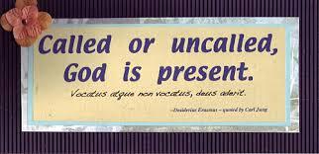
Callings are Both General and Particular
GENERAL
By virtue of our Baptism we are called into community – to love God and our neighbor
PARTICULAR
God’s call can be found in the place that you are!
At a particular time
At a particular place
Gifted with particular abilities, disabilities, experience and associations
DISCERNING GOD’S CALL
Is this a source of joy?
Does this tap into your talents and gifts?
Is this role of genuine service to people around you and to society at large?

Slide 9
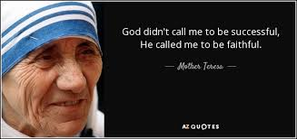
Called to life
In the midst of life’s busyness, we don’t always take time to reflect on the deeper meaning of our lives in light of our faith.
Calling and Vocation are used interchangeably to describe how God works in our lives
Four practices:
Praying
Sharing
Reflecting
Listening

Slide 10
praying
Prayerful discernment – sifting through all the voices and choices facing us in order to hear and follow the voice of God
Lectio Divina – slow, quiet and thoughtful encounter with Scripture. Slowly reading and reflecting on the biblical passage three times provides time and space for God’s Word to move from our lips, into our minds, and finally into our hearts.
ALL: Lord open my heart to reflect on your call in my life and for your world. Amen

Slide 11
Deuteronomy 30:11-15, 19-20
Moses said to the people: “Surely, this commandment that I am commanding you today is not too hard for you, nor is it too far away. It is not in heaven, that you should say, ‘Who will go up to heaven forus, and get it for us so that we may hear it and observe it?’ Neither is it beyond the sea that you should say, “Who will cross to the other side of the sea for us, and get it for us so that we may hear it and observe it?’ No, the word is very near to you; it is in your mouth and in your heart for you to observe.
See, I have set before you today life and prosperity, death and adversity…Choose life so that you and your descendants may live, loving the Lord your God, obeying him, and holding fast to him; for that means life to you and length of days, so that you may live in the land that the Lord swore to give to your ancestors, to Abraham, to Isaac, and to Jacob.”

Slide 12
praying
ALL: Lord open my heart to reflect on your call in my life and for your world. Amen
Listen to first reading of Scripture;
Choose a word or phrase that strikes you
Reflect on that word or phrase -What might God be saying to you?
Listen to the second reading of Scripture
Choose a word or phrase that strikes you
Reflect on that word or phrase – How might God be calling you to act through the word or phrase that first struck you? How might you respond?
Share with one other person

Slide 13
Lord, open my heart to reflect on your call in my life and for your world. Amen.

Slide 14
Telling Our Stories
The Stories We Live – Finding God’s Calling All around us
By Kathleen A Cahalan

Slide 15
We can talk about callings using nouns, verbs and prepositions:
Noun: vocation, meaning (static, passive and singular)
Verb: Actions of our lives respond to God’s callings (whisper, shout, nag, push)
Prepositions: connects words to other words; expresses relationships (by, to, from, in, through, with, for)
Nouns, verbs, and prepositions are all necessary to storytelling
The Stories We Live

Slide 16
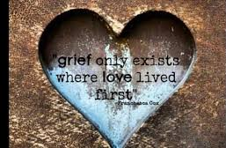
Different Dimensions of Our Callings
Called by God
Called to follow the way shown by Jesus
Called as unique persons with particular history and circumstances
Called from the losses and grief we suffer
Called to give our lives for others
Called in our deepest suffering to carry out God’s purposes in mysterious ways
Called through the people in our lives (vocation takes root in community)
Called together to live within God’s loving embrace, both now and in the live to come
We find our callings within the stories of our lives.

Slide 17
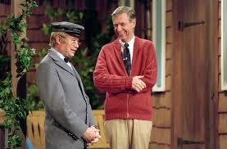
Called to be followers of Christ in community with other disciples
Jesus does the calling – “Come Follow Me!”
Worshiper –heart is filled with adoration and love for the source of life (in what way do I worship Jesus)
Our worship is the recognition of the goodness and power of divine blessing in our lives – we rejoice, falling on our knees and singing God’s praises.
Witness – to tell the truth about what God is doing in your life
How has God called, nurtured, converted or healed you?
Neighbor – one who dwells nearby; caring for others beyond one’s family/tribe; the poor, the outcast, and those we despise
Forgiver – forgive those who harm us and seek forgiveness when we harm others
Prophet – to declare what is wrong with our neighborhoods and call our neighborhoods back to right relationship through justice and mercy – When have you felt called to be prophetic? Did you embrace the call readily or cringe at the prospect
Steward – one who cares for the household of God’s creation, accepting it as a gift, not as something we own and control

Slide 18
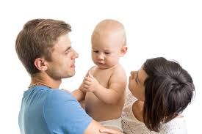
Multiplicity of callings as disciples
Living a Centered Life – faithful to God in each moment (A life centered in the triune God gives identity and a place to stand in a chaotic and compartmentalized world. The Creator God is present in all I do.)
With God at the center of my life, I know whose I am and can begin to discover who I am.
God’s call can be found in each part of your life, which eventually gives direction, meaning, and purpose to the whole of your life.
Relationship: (spouse, parent, daughter, friend)
Specific Roles (coworker, teacher, volunteer, boss)
Ways of Being (loyal, encouraging, compassionate)
Particular Gifts or Abilities (connector, thinker, provider, problem solver, blood donor)

Slide 19
Hearing God’s voice (truth, authenticity, integrity)
Gods voice is within each of us as a source of divine wisdom, mysteriously both beyond and within ourselves.
God uses the inclinations of our true self, the promptings of conscience, to help guide and call us through decision big and small toward the goal or purpose for which we were created.

Slide 20
The goal of vocation is to find and live out of god’s truth
A truth that takes on particularity in your life
the truth of who you are and how you live.

Slide 21
Search for true self vs. false self
True Self
There is something you know you cannot NOT do
Give your life as a witness to the truth about who you are
Lose our life in loving service
False Self
Our lives become mired in sin
Selfishness and Self destructive ways
Seeks its own good, making ‘me’ important

Slide 22
God calls us in the particularities of our life context shapes our calling
All people want to be valued for who they are, not just for what they do. For most, it is a lifelong journey to discover who they are.
Vocation is God’s call to your life’s particularities: gender, family, ethnicity, time in history, education, opportunities, relationships, culture.
God calls each of us by name, not in a generic way but specific to your time in life and place in the history of the world.
God creates each of us to be children of God, but we can only live out our callings within our time and place.

Slide 23
Take two minutes to write the answers
Have you experienced being called by God? When did you feel God’s presence, nudge, or invitation?
Have you ever seen God’s hand at work by looking back at your life?
The Plan – God as Divine Planner – is there only one way to get it right for each person?
God’s plan for all of us is to live and work for the sake of God’s mission in the world
The Pilgrimage – the Journey or even an exile
Pilgrims experience a call to follow a particular way and trust in God’s companionship, no matter what happens along the way
The surprising “aha!” moment – being awakened to a gift or develop a passion
How did you discern that calling?

Slide 24
Presentation’s Commitment:
Recruit team members to infuse the theological theme of Calling throughout the ministries of the church for the calendar years 2018-2020
Work in a covenantal relationship with our coach, Denise Utter
Innovate with calling activities across the various pages of the parish.
Pilot a new design with at least five groups: children, adolescents, young adults, adults (midlife-mature) and the whole family + one project/design with the unaffiliated/uninvolved.

Slide 25
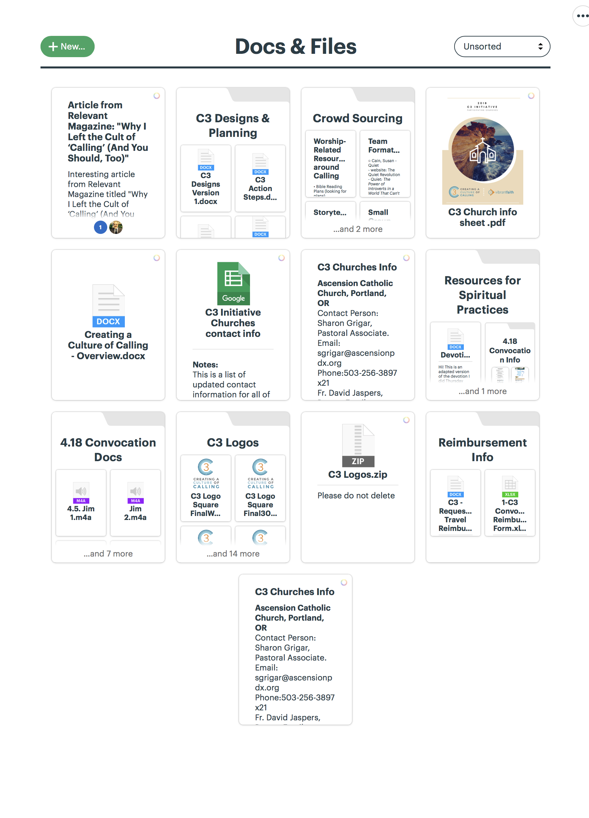
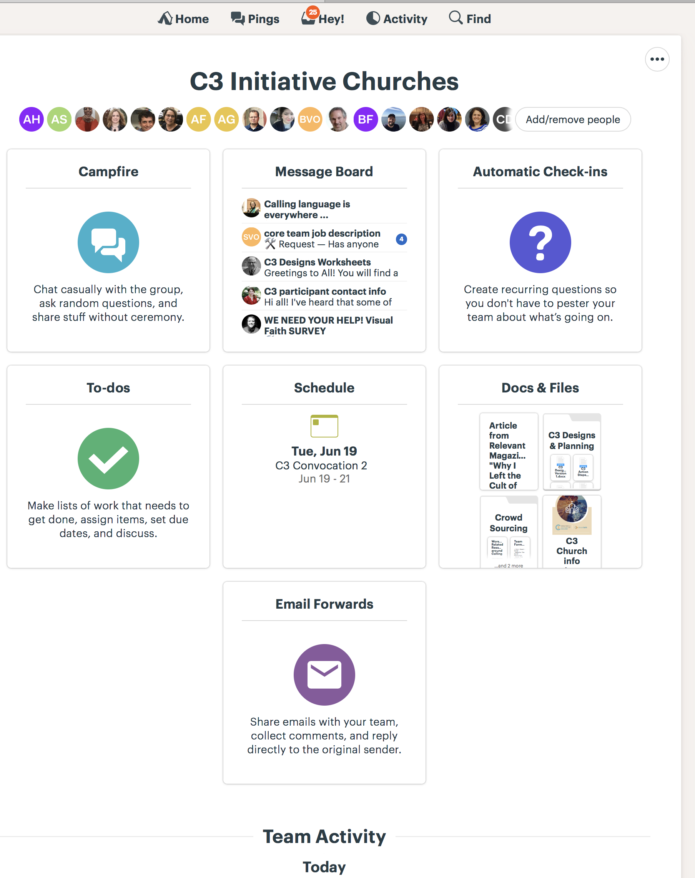
Vibrant Faith’s Commitment to Us
Training the parish leadership team at two Convocations in 2018, one in 2019 and one in 2020
Each parish will have one coach to work with them for three years.
Resources through web portal that provides and allows for parish development of print, audio, video and digital vocation activities and resources
Network of parishes online

Slide 26
Vocation is about the whole of your life, Your whole life long!
Infants called to gaze and behold
Children called to create, imagine, invent, and delight in
Youth called to begin exploring identity, developing a sense of self
Young adulthood called to ask big questions and discover worthy dreams
Adulthood called to love and work – gaps between dreams and reality
Midlife called through disillusionment to explore how to serve with greater integrity and service
Retirement called to reevaluate where I live, who I love, how I serve and what I’ll do
Elder years called to live with ambiguity, uncertainty and the need for care marked by the need to give and to let go

Slide 27
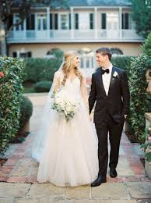
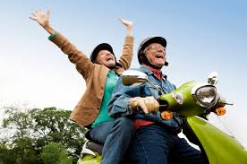
Called from something, someone or somewhere - transitions
Being called from entails moving away, an ending, before a new beginning
Need to trust that moving away is the right path, a calling, even though you do not know the destination
Graduation
Wedding
New Job
Retirement
Loss – object, relationship, role, function or a community

Slide 28
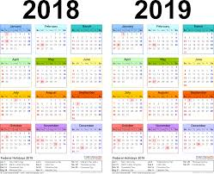
Brainstorm experiences of calling to embed in 2018 - 2019 schedule

Slide 29
Whole Community Idea starter
Sunday Worship
Homilies
Music
Ritual Action
Interview Project (modeled on Story Corps) – Church-wide “Stories of Call”
Film Festival on callings and vocation
Intergenerational Programs on Calling using eight Core Calling Themes
Called by God
Called to Follow Christ
Called as We Are
Called from People, Places or Situations
Called for Service and Work
Called through Each Other
Called in Suffering
Called by the God Within

Slide 30
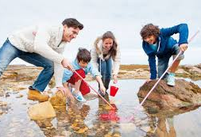
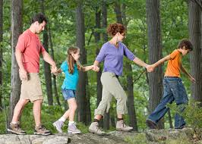
Family Idea starter
Family-centered programs at church using the eight core Calling themes
Family at-home friendly activities
Parent formation on discovering and living the call to be parents

Slide 31
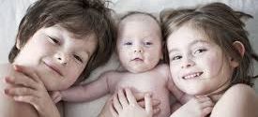
Life Stage Idea starter
Milestone and transitions
Resources for Baptism parents – on Belonging
The First Child – parenting resources
Additional Pre-Cana resources
Retirement – dinner for retirees

Slide 32
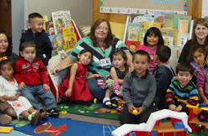
Children idea starters
Fife-sessions on Call stories in the Bible
Lenten series on Call – Spiritual Explorers
Children and parent sessions at gathering

Slide 33
Adolescents idea starters
Retreat experience designed around the eight core Calling themes
Youth meetings focused on each of the eight core Calling themes
Confirmation program incorporating the eight core Calling themes
Lenten series on Call
Calling in Adolescence through “Sparks” discovery experiences
Apprenticeships in the community to explore Callings
11-12th grade discernment program/retreat on discovering and living your call as a young adult

Slide 34
Young adults starter ideas
Introductory programs on discovering one’s calling/vocation
4-session video program: “Vocation: How does God call us to live our faith?”
Retreat experience on discerning and living one’s call as a young adult
Book study: The Stories We Live
Online course: The Stories We Live
Mentoring relationship with older members of the faith community
Online discernment tool and one-to-one discussion
Developing a personal call statement
Bible reading plans on Calling
Career mentoring/workshops for the community

Slide 35
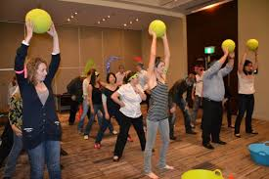
Adults idea starters
Introductory programs on discovering one’s calling/vocation
4-session video program: “Vocation: How does God call us to live our faith?”
Retreat experience on discerning and living one’s call as a young adult
Book study: The Stories We Live
Online course: The Stories We Live
Retirement and Calling Retreat or Workshop
Online discernment tool and one-to-one discussion
Developing a personal call statement
Bible reading plans on Calling
Career mentoring/workshops for the community

Slide 36
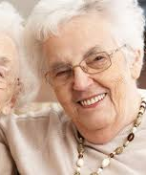
Seniors and elderly starter ideas
Introductory programs on discovering one’s calling/vocation throughout life
4-session video program: “Vocation: How does God call us to live our faith?”
Retreat experience on discerning and living one’s call as a young adult
Book study: The Stories We Live
Online course: The Stories We Live
Retirement and Calling Retreat or Workshop
Online discernment tool and one-to-one discussion
Developing a personal call statement
Bible reading plans on Calling
Career mentoring/workshops for the community

Slide 37
How can flock note be used in creating a culture of calling
Unlimited emails and text messages
Helpful analytics
Targeted messaging
Unlimited groups & admins
Sub-group hierarchies
Control over admin levels
Your members can customize how they hear from you
Export all your data any time
Send test emails
Member photos
Duplicate notes
Welcome messages.
Free content
We also have a growing library of free content (campaigns, email newsletters, sample text messages to engage your flock, etc.) at your disposal that you can take, edit, and make your own at any time.

Slide 38
Core and Leadership Teams
Core Team – reflect a diversity of roles and ministries
Pastor
Pastoral Leaders
Coordinator of Faith Formation
Leaders in Faith Formation with Children, youth, young adults, adults, and families
Brainstorming Leadership Team
Active participants in the mission and ministries of the parish
Positive, proactive, prayerful, team players who posses a growth mindset
Accessible by phone and email and provide timely responses to questions between meeting
Track record of following through on commitments and responsibilities
Strong network of relationships at and beyond the church
Respectful of the church’s history and traditions yet open to finding better ways to fulfill its mission & vision
Can realistically make the time commitment called for in initiative

Slide 39
What part will you play?
Visual Faith Experience
“Listen! I am standing at the door, knocking; if you hear my voice and open the door, I will come in to you and eat with you, and you with me. Let anyone who has an ear listen to what the Spirit is saying to the churches.” Revelation 3:20, 22

Slide 40
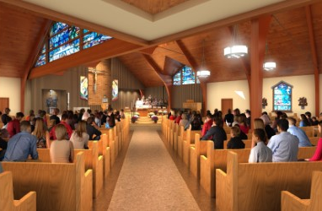
“When you reach out to follow your calling, the universe supports you with a world of possibilities.” ~Diane Dreher
WHAT’S NEXT?
April 23, 1-3pm – Full Staff Meeting
May 14th, 7 pm – Core Team First Meeting
June 19-22 – Convocation #2
Sept. 16^{h} 10 am – Family Faith Launch
Dec. 2nd – Parish Launch – We are Called by Name

